Slide 1
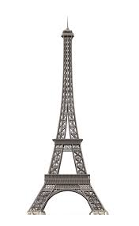
Mystery Architecture
Robert C Fisler Elemtary Science Olympiad
All Grades Event
March 16th, 2019

Slide 2
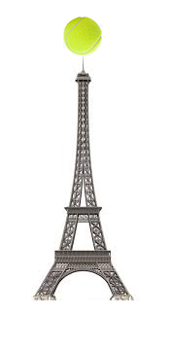
Description
This event is designed to test the student's ability to think on their feet. They will be given a bag of materials to build a freestanding tower as high as they can. The tower should be constructed to support a tennis ball at its top.

Slide 3
Rules
Each team of two students will be given a bag of building materials. All teams will receive exactly the same materials. The materials might include: straight pins, paper cups, drinking straws, paper clips, tape, string, paper, etc. (This list is only an example; the actual materials may be anything that the supervisors feel are appropriate) .
Each team will have a maximum time of 20 minutes to construct a tower to support the tennis ball at its highest point. The top of the tennis ball must be higher than any part of the structure.

Slide 4
Rules Continued
Only those materials supplied in the bag, and the bag itself, may be used to construct the tower. No other materials or adhesives may be part of the finished tower.
Students may bring scissors, a ruler and a pair of pliers, which they will provide, to use as tools while building the tower.
Each team may bring their own tennis ball to use while building their tower, however, all towers will be measured using the same tennis ball (regulation size and weight) provided by the event supervisor.

Slide 5
Rules Continued
The students are to inform the judges when they finish their tower. They will place the tennis ball provided by the event supervisor on the top of their tower. The tower must remain standing long enough for the height and base to be measured
The tower must be completely free standing. It cannot be attached to the tabletop, floor, wall or ceiling.
No coaching of the students will be allowed during the competition.

Slide 6
Scoring
The height of the tower and the width of its base will be measured as precisely as possible by the judges. Since no building materials are to extend above it, the top of the tennis ball will be considered the highest point of the tower. The width of the tower will be measured at its base. The largest diameter of the base will be recorded.
All towers that support the tennis ball will be ranked above those that do not. The towers in each of these groups will be ranked according to their height. Tallest tower first, the shortest tower last.
In the event of a tie, the winner will be the tower with the smallest base measurement.

Slide 7
Types of Forces: Tension
Tension : the member is being “pulled” on

Slide 8
Types of Forces: Tension
Good Tension materials:
Straws
String
Pipe cleaner (wire)
Paperclips
Paper (rolled)

Slide 9
Types of forces: Compression
Compression : the member is being “squished”

Slide 10
Good Compression Materials:
Straws
Toothpicks
Popsicle sticks
Cups
Rolled up paper

Slide 11
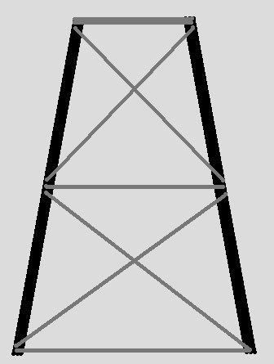
Good Engineering Load Bearing
Load Platform
Legs
Cross Bracing

Slide 12
We got …
Paper
Teach the students to roll paper
Save that sheet of paper you were going to throw away
Roll the paper tightly – great strength
Although sometimes a wider roll will do the job
Can be cut into shorter lengths to meet student’s plan
Can be used to support load

Slide 13
We got … cont’d
Tape
Double the length – tear tape in half
One student can tear some into lengths and hang from table while other does something else
Paper clips
Can be ‘unrolled’ to increase length
Can be cut with side snip pliers
Can be bent until they break

Slide 14
We got … more
Pipe cleaners
Can tie things together
Long – can be cut into pieces with pliers
Can wrap around or threaded through
String
Is it wrapped cord? – unwrap to increase length provided
Tie short – no long hanging ends
Increases usable length

Slide 15
We got … and this
Index cards or card stock
Can be rolled for strength
Can be folded to add support
But no creases
Support for mass
Craft sticks (popsicle sticks)
Great strength
Pierced with scissors or paper clips

Slide 16
We got … maybe this
Straws
Bendable or straight
Great for gaining distance
Probably better vertical than horizontal
Can be cut to point to jam one into another
End can be flattened to join with tape, paper clips, or pipe cleaners

Slide 17
We got … or maybe
Skewers
Watch out for pointed end
Great strength for height or length
Can be ‘stabbed’ through plates, cups, 3x5 cards

Slide 18
We got … the list goes on
Plates – paper or foam
Make a great base
Can be ‘stabbed’ with skewers, especially foam
Can be rolled if paper
BUT – remember that inside dimension could be from edge of plate to edge of plate

Slide 19
We got … and there’s
Cups
Paper or plastic or foam – use might depend on type
Make great bases
Can be stabbed
Items can be taped to them

Slide 20
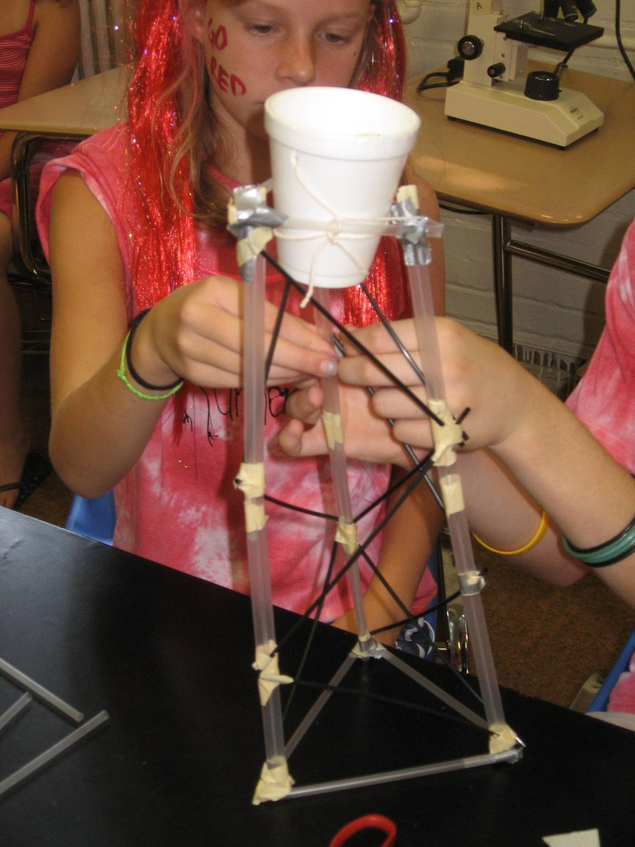
Examples
Good:
Doubled up straws for legs
Triangles for bracing
Bad:
Not level

Slide 21
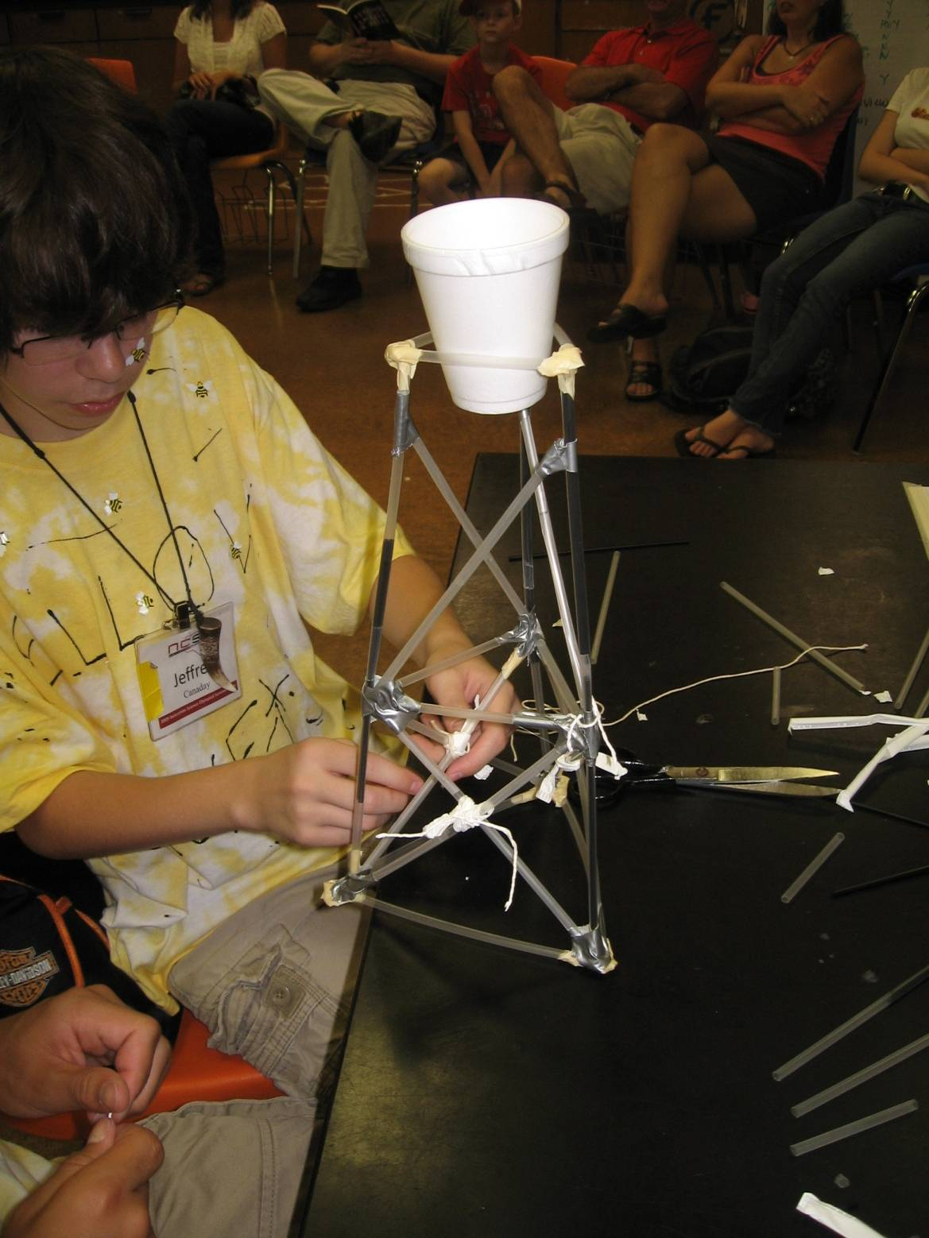
Examples
Good:
Very level
Triangles for bracing
Bad:
Legs are single straws instead of double

Slide 22
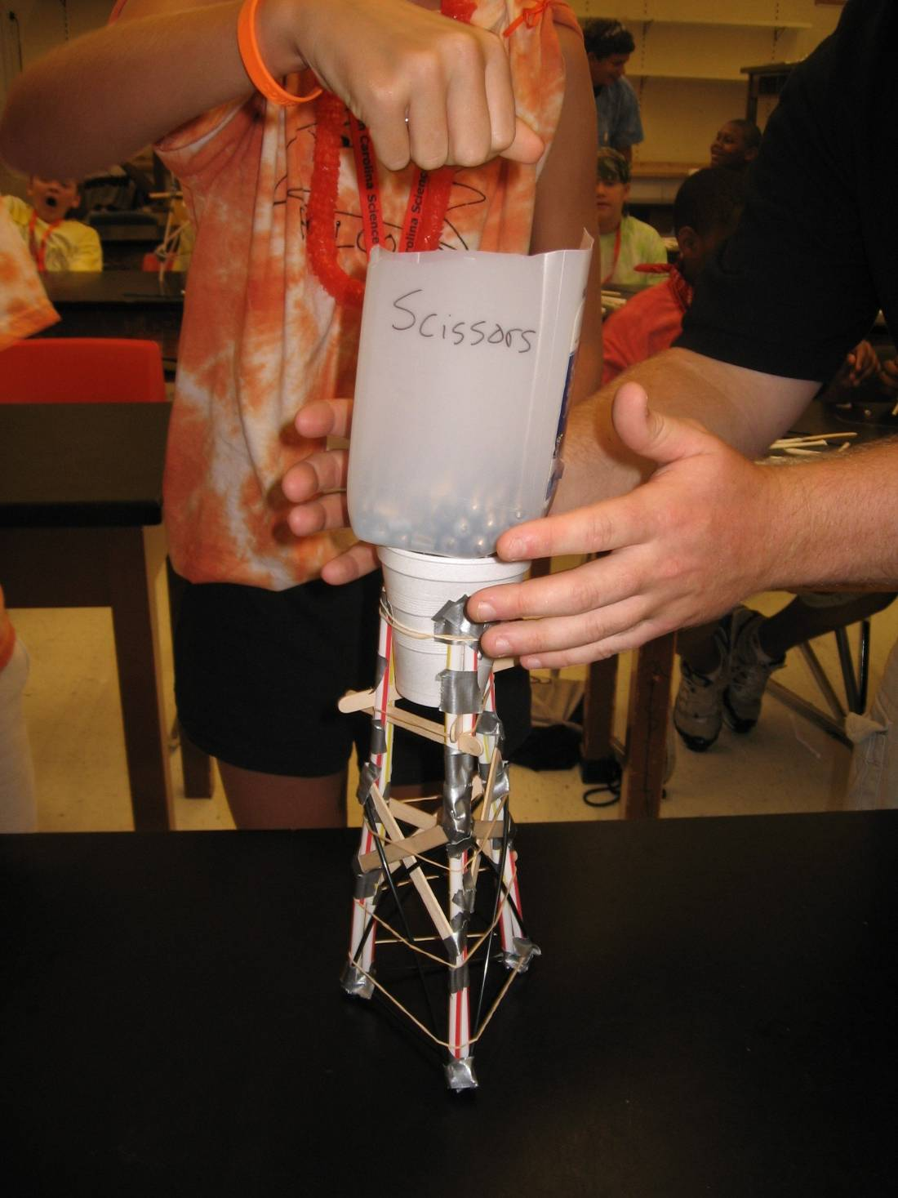
Examples
Good:
Very level
Triangles for bracing
Multi-strawed legs
Bad:
Added extra materials just to use them

Slide 23
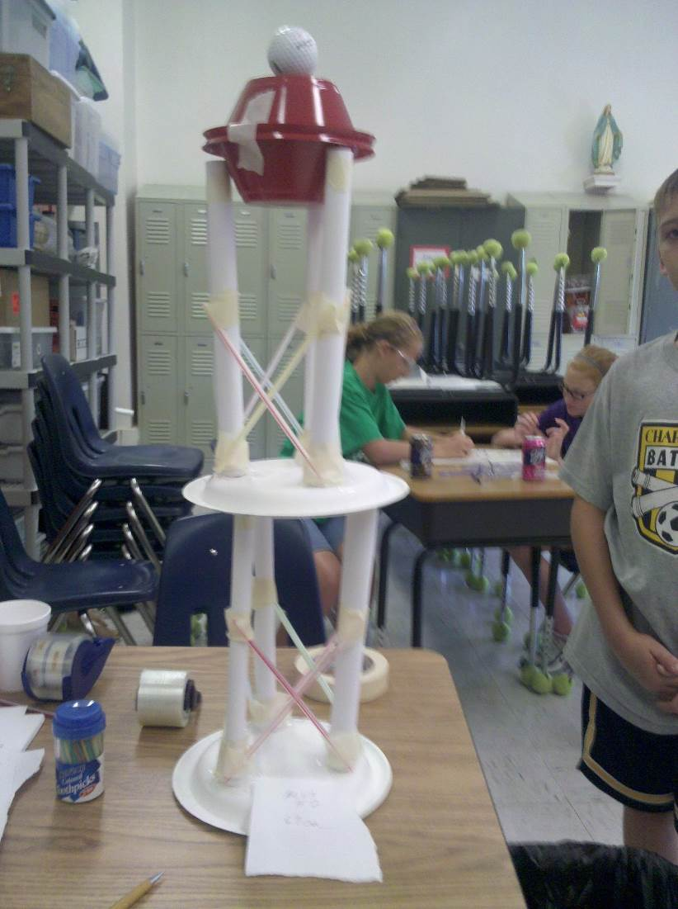
Some ideas
Good:
Rolled paper for strength
Cross bracing with triangles
Use of bowls for added height
Bad:
Off center

Slide 24
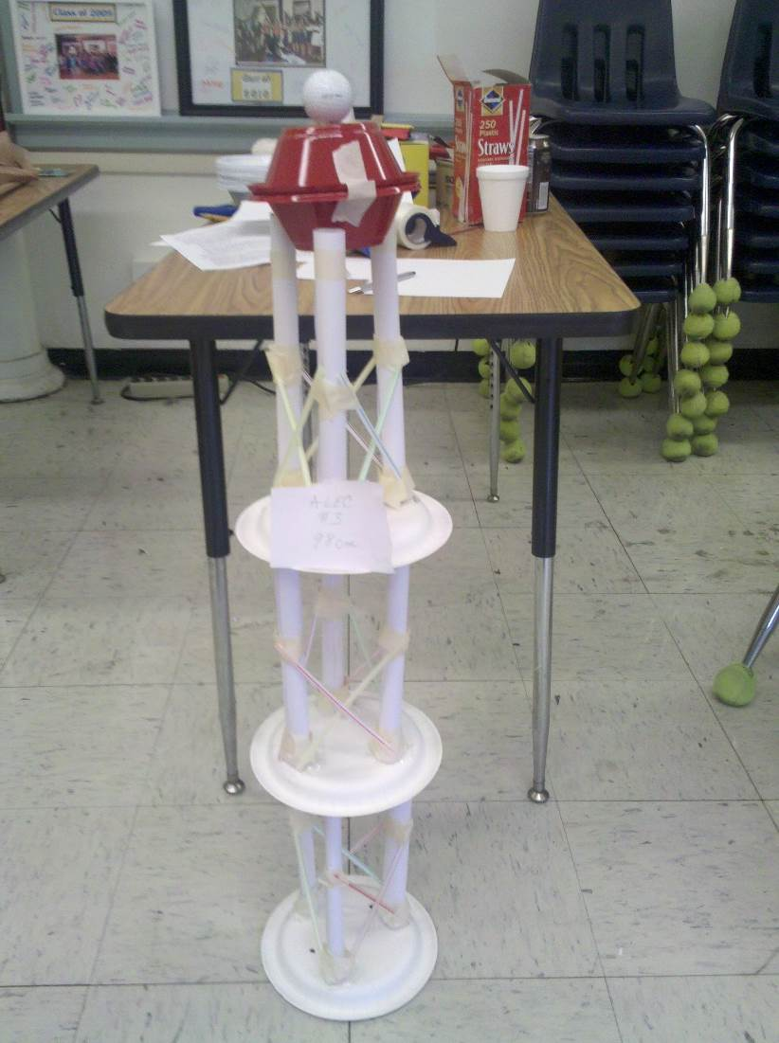
Taller yet
Good:
Centered for stability

Slide 25
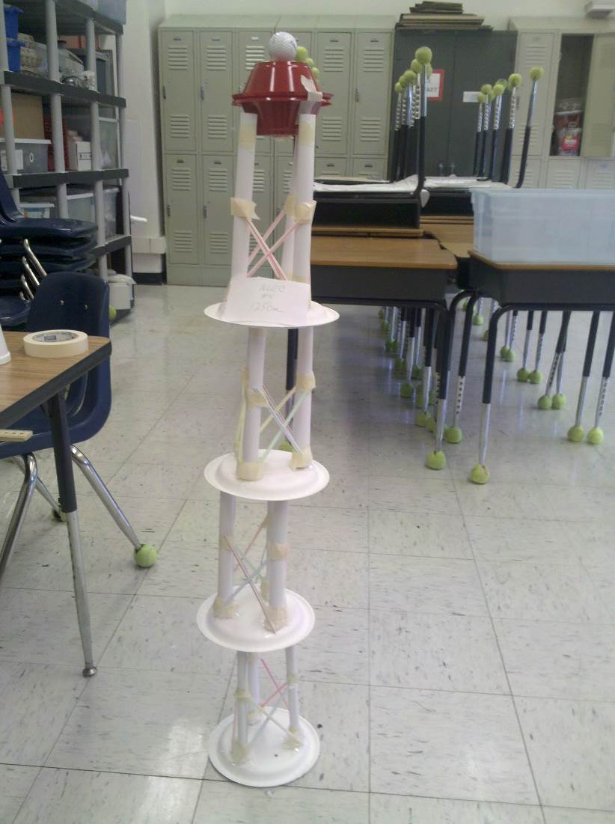
Still taller, but…
Good:
Great height
Bad:
Off center
Beginning to lean

Slide 26
Teaching idea - square
Use 4 pipe cleaners and 4 drinking straws to form a square. Insert the pipe cleaners through the straw and twist them together at the corners. Stand the square on edge and apply a downward force to the top of it. The square deform easily due to the weakness of the corner joints. - square

Slide 27
Teaching idea - Triangle
Make a triangle in the same manner using 3 pipe cleaners and straws and test it as you did the square. The triangle won’t change shape unless you push hard enough for either a joint or one of the straws to break.

Slide 28
Another training idea - square
Take the square built of straws and pipe cleaners and add one cross brace of pipe cleaner or string.
Show how it will be strong in one direction but weak in the other.
Add the second brace to demonstrate increased strength and resistance to collapsing.
Remind them of the value of triangles.

Slide 29
Ok Lets Practice
You have the next 15 minutes to build a tower using the materials in the Bag

