Slide 1
Circuit Wizardry
2019 Robert C Fisler Elementary Science Olympiad Competition
4th Grade Event

Slide 2
Short Video on Electricity
https://youtu.be/EJeAuQ7pkpc

Slide 3
Terms you need to know
Conductor: A material through which heat or electricity flows easily
Insulator: A material through which heat or electricity does not flow very well
Closed Circuit: A complete path that electricity can flow through
Open Circuit: A broken or incomplete path that electricity cannot flow through
Short Circuit: A problem in an electrical circuit where two or more wires that are not supposed to come in contact with each other touch.
Normally open Switch: A switch that in its normal state won’t conduct electricity until the switch is activated
Normally Closed Switch: A switch that in its normal state will conduct electricity until the switch is activated
Series Circuit: A circuit in which the current must flow through each electrical device in order to complete the circuit
Parallel Circuit: A circuit in which each electrical device is independently connected to the electrical source
Series-Parallel Circuit: A circuit in which some electrical devices work in series and some work in parallel

Slide 4
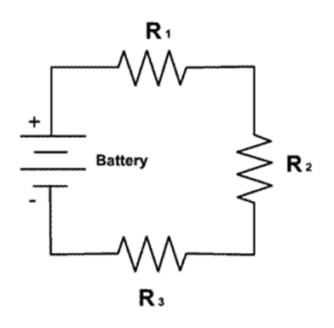
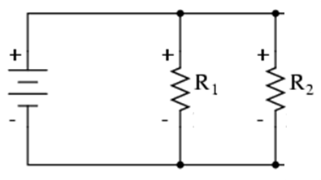
Series versus Parallel Circuits
https://www.youtube.com/watch?v=x2EuYqj_0Uk

Slide 5
Circuits can be described in a variety of ways
They can be described with words
Ex. A circuit contains a light bulb and a 1.5-Volt D-cell.
They can be described with pictures
Ex.
They can also be described with symbols (we call this a Schematic)
Ex.

Slide 6
Schematic Symbols you need to know
Battery (One Cell)
Battery (Multi-Cell)
Light Bulb
Switch Normally Open
Switch Normally Closed
Conductor (wire)
Crossed Conductors
(Not Connected)
Crossed Conductors
(Connected)
Fuse
Resistor

Slide 7
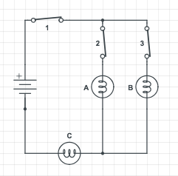
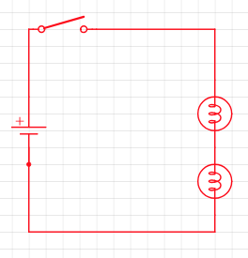
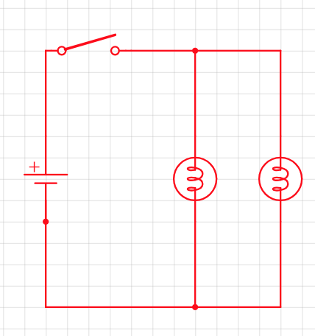
Example schematics

Slide 8
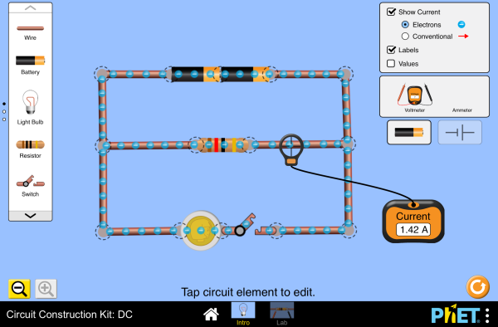
Lets Play
Goto Fislerso.com and click on Event Resources, then click on the picture that looks like below

Slide 9
Practice
Create a Series circuit with 1 Battery 2 light bulbs and a switch to turn both batteries on or off at the same time
Create a parallel circuit with the same components as above
Add switches to your above circuit so that you can turn each bulb off individually

